Slide 1
Notes on Quiz 1
In-class
If you are taking quiz remotely:
You only need to study what we discussed in class (not HW1)
Requires pencil/pen
Closed-book
10 minutes
Keep up-to-date via Piazza
Quiz PDF will be posted at the agreed-upon time on Blackboard
You must have your camera with full view of your quiz and hands and screenshare on
You have 5 minutes after the exam to send us a scan or picture of your quiz
(you cannot write answers or make notes on screen as everyone will see what you write)

Slide 2
HW 1
Due today!
Note, we removed the supplementary module requirement to make it easier for you
You will get full credit if you completed all required modules
You will get +5% on your HW1 grade for completing all optional modules

Slide 3
Looking forward
HW2
Project proposal due January 31, 4 p.m. via Blackboard
We will post HW 2 on Monday, January 22
This is due February 7 4 p.m.
Should only include:
Title
Authors
Project Description
Ideal presentation date
I suggest at least 3-5 references. This would show support about any claim you are making in your project description.

Slide 4
Project examples
Bias in COVID-19 Detection from Audio
Bias in Mate Selection for Speed Dating
“This project focuses on looking for biases that exist in COVID-19 detection based on coughing sounds. We hope to explore whether the cough sound screening can be a more cost-effective but reliable alternative to the PCR test in the post covid period. In particular, we will
work on checking the accuracy and reliability of detection results for all age groups, genders, etc.”
“...The trained [dating app] models will, however, reflect the data’s biases towards particular demographic groupings, but few researchers have paid attention to them. In our work, we build regression models combined with pre-processing
techniques to perform the dating successful rate prediction, and deploy a number of evaluation mechanisms
combined with visualizations to identify …bias”

Slide 5
Questions to ask
What do you want to predict?
What are common datasets? Are some demographics over/underrepresented in these data?
What are common features gleaned from these data? Do they harm certain classes? Example: hate detection model that flags people who use AAE

Slide 6
UNSUPERVISED LEARNING
Keith Burghardt
USC Information Sciences Institute
January 17, 2024

Slide 7
Learning Approaches
Supervised
Learning
Unsupervised Learning
The training data is annotated with information to help the learning system
Eg. the class for each instance
The training data is not annotated with any extra information to help the learning system
Eg. clustering of data

Slide 8
WHY UNSUPERVISED LEARNING?

Slide 9
Why unsupervised learning?
y | x₁ | x₂ | … | x_{m}
Learning from unlabeled data
Usually, no ground truth data, labels or outcomes are given
“If intelligence was a cake, unsupervised learning would be the cake, supervised learning would be the icing on the cake, and reinforcement learning would be the cherry on the cake.” – Yann LeCun
y
x₁
x₂
…
x_{p}
1st instance
features
Outcomes/labels
n^{th} instance

Slide 10
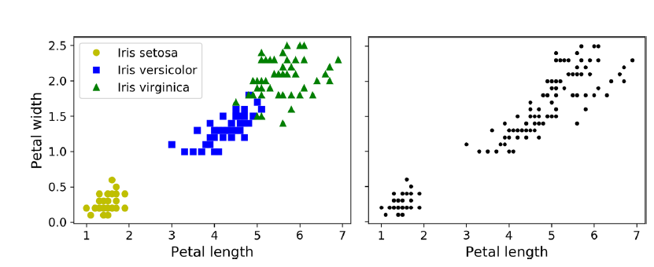
What is unsupervised learning?
Supervised learning: e.g, Classification
Unsupervised learning:
Just as in classification, each data point is assigned to a group/label
But groups/labels are not known
But we got data! (sometimes a lot!)
And what can we find in the data?

Slide 11
What is clustering?
Want to find a ‘natural’ grouping between data instances
We want to find ‘similar’ instances and treat them in the same way
No universal definition of what a good cluster is. Different algorithms capture different kinds of clusters.
Data points near a centroid
Dense regions
Well-separated regions
Data instances within a cluster are closer to each other than to data points in different clusters
High intra-cluster similarity
Low inter-cluster similarity

Slide 12
Issues to consider
Nature of clusters
Set of clusters or hierarchy of clusters?
Crisp or fuzzy?
Distant compact sets of items vs dense sets separated by low-density regions
How many clusters are there?
Nature of items
Numeric? Categoric? High-dimensional?
If multi-dimensional, are values of a similar order of magnitude, or do some dominate?
How to measure similarity?
Are the clusters valid?
External validity: e.g., prior knowledge of the problem
Internal validity: do the clusters fit the data well?

Slide 13
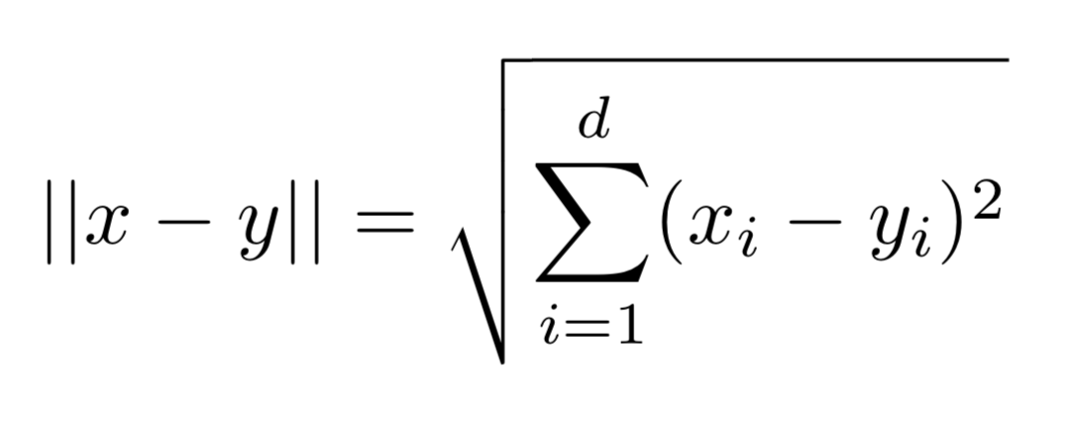
What does it mean for items to be similar?
How to define similarity is one of the most important questions in unsupervised learning.
Similarity often measured using distance measures (e.g. Euclidean distance, or Mahalanobis Distance)

Slide 14
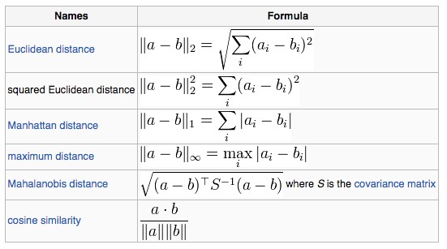
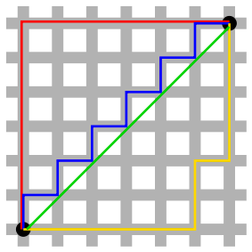
Numeric Distance Metrics
Source: Wikipedia
Notes:
It is a multi-dimensional generalization of the idea of measuring how many standard deviations away P is from the mean of D.

Slide 15
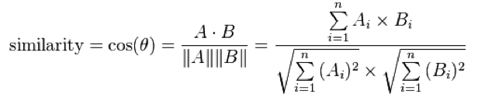
Cosine Distance
Similarity = Cosine of angle btw vectors: A & B
Numerator is the dot product of vectors A and B
Denominator is the product of the Euclidean distance of each vector from the origin
(length of the vector)
distance = 1- Cosine(A, B)
b
a
c

Slide 16
Symbolic Distance Metrics
Hamming distance between two symbolic strings of equal length is the number of positions at which the corresponding systems are different.
Measures the minimum number of substitutions required to change one string into the other
Levenshtein (edit) distance is a metric for measuring the amount of difference between two sequences.
Is defined as the minimum number of edits needed to transform one string into the other.
1001001
1000100HD = 3
LD(BIOLOGY, BIOLOGIA) = 2
BIOLOGY -> BIOLOGI (1 substitution) BIOLO G I -> BIOLOGIA (1 insertion)
Source: http://www.astro.caltech.edu/~george/aybi199/Donalek_Classif.pdf

Slide 17
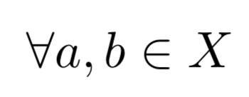
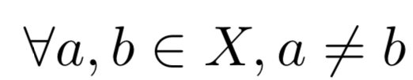
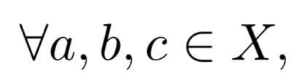
Similarity measure must be a metric
You can choose any distance measure as similarity metric
Distance metrics satisfy the following properties (axioms): Given a distance measure d(.,.)
Self-similarity: d(a, a) = d(b, b),
Minimality: d(a, a) < d(a, b),
Symmetry: d(a, b) = d(b, a),
Triangle inequality: d(a, b)+ d(b, c) >= d(a, c),

Slide 18
DATA STANDARDIZATION

Slide 19
Data Standardization
In the Euclidean space, standardization of features is recommended so that all attributes can have equal impact on the computation of distances.
Consider the following pair of data points
x_{i}: (0.1, 20) and x_{j}: (0.9, 720).
dist(xi, xj) = (0.9 − 0.1)² + (720 − 20)² = 700.00,
The distance is almost completely dominated by (720-20) = 700.
Standardize attributes: force features to have a common range
Source: https://www.cs.uic.edu/~liub/
13

Slide 20
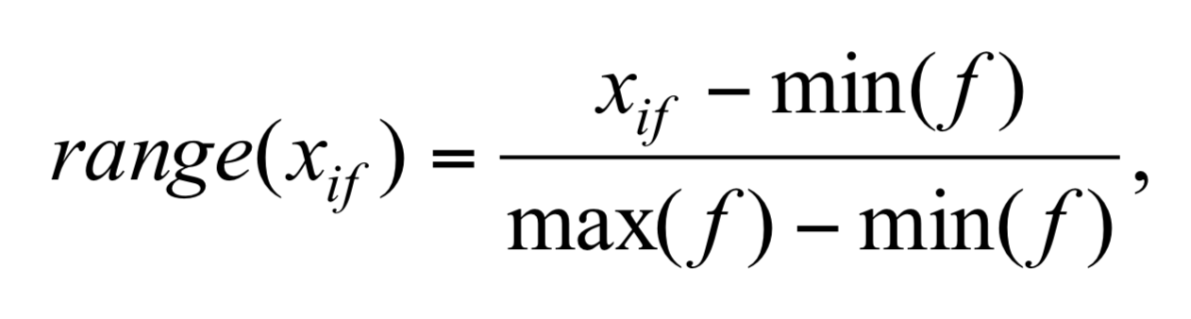
Interval-scaled attributes
Their values are real numbers following a linear scale
The difference in Age between 10 and 20 is the same as that between 40 and 50.
The key idea is that intervals keep the same importance throughout the scale
Two main approaches to standardize interval scaled attributes, range and z-score. f is an attribute
Source: https://www.cs.uic.edu/~liub/
14

Slide 21

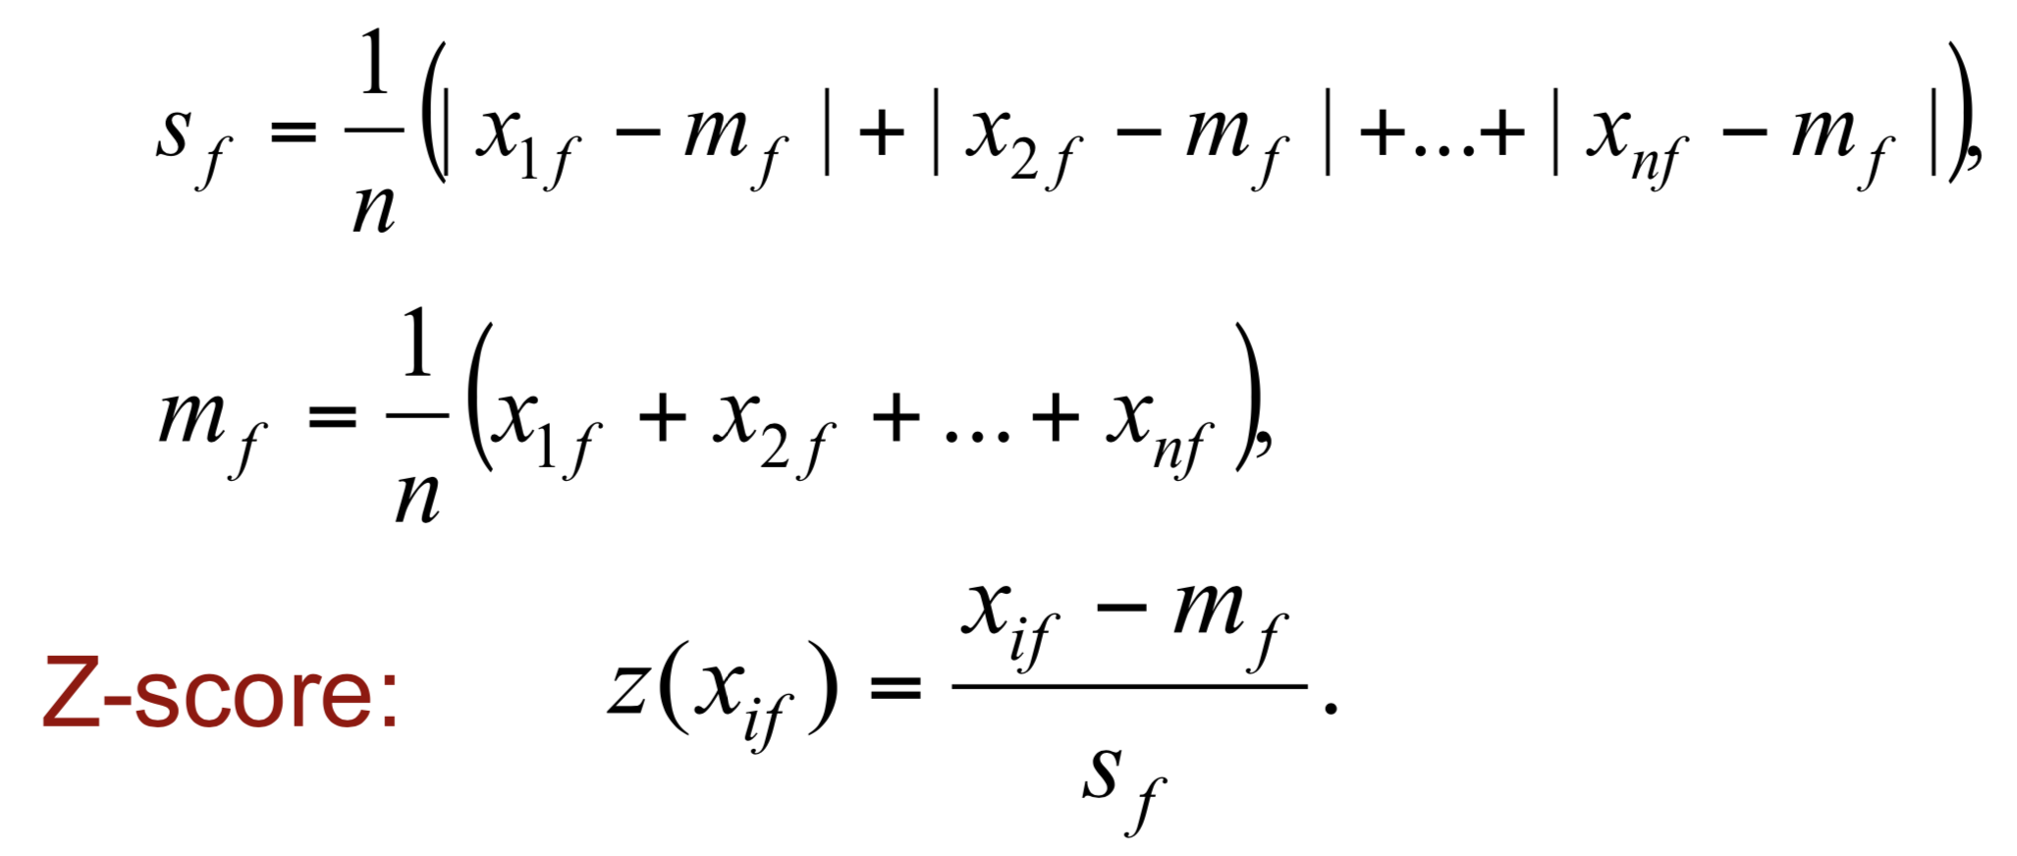
Interval-scaled attributes
Z-score: transforms the attribute values so that they have a mean of zero and a mean absolute deviation of 1. The mean absolute deviation of attribute f, denoted by s_{f}, is computed as follows
Source: https://www.cs.uic.edu/~liub/
15

Slide 22
Ratio-scaled attributes
Numeric attributes, but unlike interval-scaled features, their scales are exponential,
For example, the total amount of microorganisms that evolve in a time t is approximately given by
Ae^{Bt},
where A and B are some positive constants.
Do log transform:
Then treat it as an interval-scaled feature
log(x_{if} )
Source: https://www.cs.uic.edu/~liub/
16

Slide 23
Nominal features
Sometimes, we need to transform nominal attributes to numeric attributes.
Transform nominal attributes to binary attributes.
The number of values of a nominal attribute is v.
Create v binary attributes to represent them.
If a data instance for the nominal attribute takes a particular value, the value of its binary attribute is set to 1, otherwise it is set to 0.
The resulting binary attributes can be used as numeric attributes, with two values, 0 and 1.
Source: https://www.cs.uic.edu/~liub/
17

Slide 24
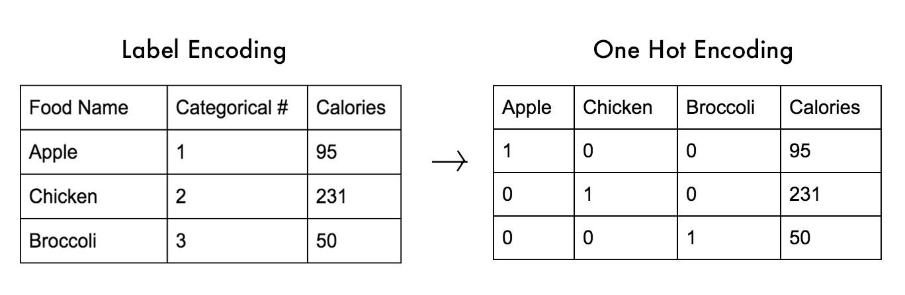
Nominal attributes: one hot encoding
Nominal attribute food: has three values,
Apple, Chicken, and Broccoli
We create three binary attributes in the new data: Apple, Chicken, and Broccoli
If a particular data instance in the original data has Apple as the value for food,
then in the transformed data, we set the value of the attribute Apple to 1, and the values of attributes Chicken and Broccoli to 0
Source: https://www.cs.uic.edu/~liub/
18

Slide 25
Ordinal attributes
Ordinal attribute: an ordinal attribute is like a nominal attribute, but its values have a numerical ordering.
Age attribute with values: Young, MiddleAge and Old. They are ordered.
Common approach to standardization: treat is as an interval-scaled attribute.

Slide 26
HIERARCHICAL CLUSTERING

Slide 27
Hierarchical Clustering
Two basic types of hierarchical clustering
Agglomerative clustering (bottom to top)
Divisive clustering (top to bottom)
Based on a pre-defined distance measure and linkage criterion we split (divisive) and merge (agglomerative) clusters depending on the type
Based on greedy search, therefore very slow and not scalable
Distance measures and linkage criteria have a big influence on the outcome of clusters!

Slide 28
Hierarchical Clustering (2)
Linkage types:
Single linkage (single minimal distance)
Complete linkage (maximal minimal distance)
Average linkage (minimal average distance)
Different problems can occur. (e.g. chaining effects)
Single linkage:
Complete linkage:

Slide 29
Dendrogram
Tree diagrams
Dendrograms are used to visualize distances and clusters
Useful for analyzing hierarchical clusters with different cut-offs
Dendrogram
0.8
0.7
0.6
Dista^{nce}
Cutoff
0.5
0.4
0.3
0.2
14 17 13 22 12 8 23 20 19 1 21 15 5 2 3 16 27 4 18 24 28 6 10 7 30 26 9 25
Data point ID

Slide 30
Agglomerative Clustering
Algorithm:
Start: each data point belongs to a separate cluster
Step: merge closest clusters based on linkage and distance
End: all data points belong to the same cluster
^{DDD}D^{iii}i^{sss}s^{ttt}t^{aaa}a^{nnn}n^{ccc}c^{eee}e
1111
2222
3333
4444
Agglomerative clustering: Step 1
Agglomerative clustering: Step 2
Agglomerative clustering: Step 3
Agglomerative clustering: Step 4
1
2
3
4

Slide 31
Example: Hierarchical clustering
(5,3)
o
(1,2)
o
o (2,1) o (4,1)
o (0,0) o (5,0)
x (1.5,1.5)
x (4.7,1.3)
x (1,1)
x (4.5,0.5)
Data:
o … data point
x … centroid
Dendrogram

Slide 32
COMPETITIVE CLUSTERING
Competitive Learning

Slide 33
Competitive Clustering
Base strategy of defining clusters with different variants
K-means clustering
Self-organizing maps
Affinity propagation, …
Again, chosen distance measure is the key
Based on the “winner takes it all” principle
After enough training steps it is assumed that winners (i.e. cluster centroids) are good representations of data within their cluster.
j* = arg min ||x - c_{j}||
j

Slide 34
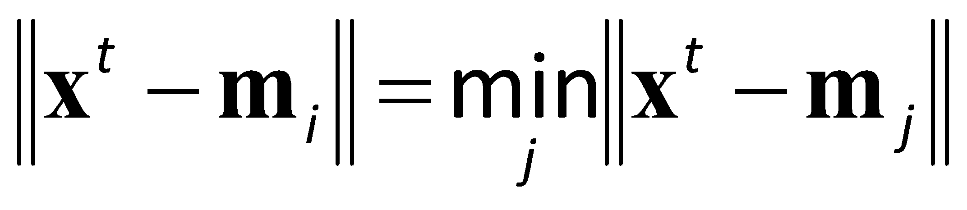
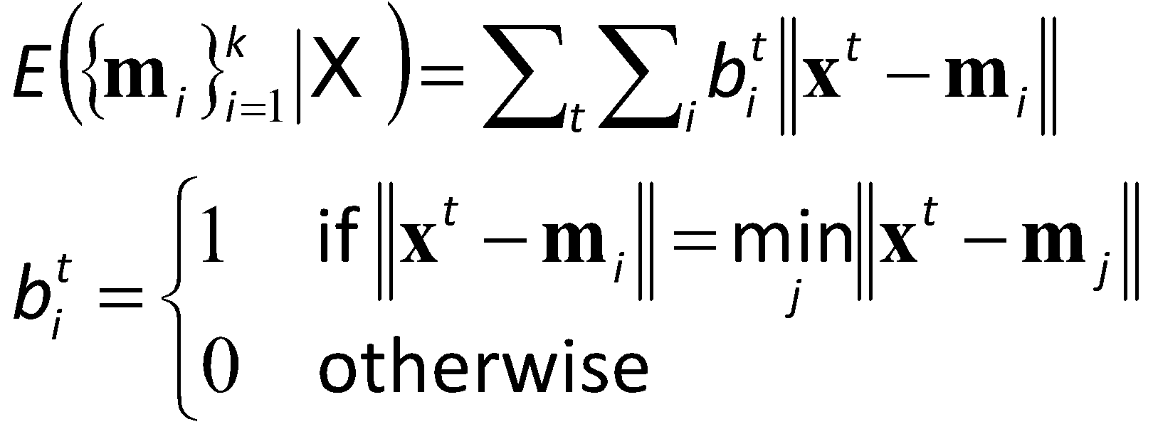
k-Means Clustering
Find k reference vectors (prototypes/codewords) which best represent data
Reference vectors, m_{j}, j =1,...,k
Use nearest (most similar) reference:
Reconstruction error

Slide 35
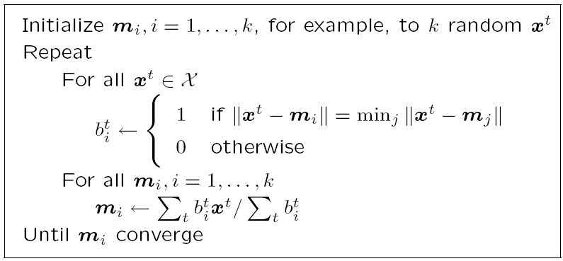
k-means Clustering
Assign to centroid
Update centroid

Slide 36
Populating Clusters
1) For each point, place it in the cluster whose current centroid it is nearest
2) After all points are assigned, update the locations of centroids of the k clusters
3) Reassign all points to their closest centroid
Sometimes moves points between clusters
Repeat 2 and 3 until convergence
Convergence: Points don’t move between clusters and centroids stabilize.

Slide 37
Example: Assigning Clusters
x
x
x
x
x
x
x
x
x
x
x
x … data point
… centroid
Clusters after round 1

Slide 38
Example: Assigning Clusters
x
x
x
x
x
x
x
x
x
x
x
x … data point
… centroid
Clusters after round 2

Slide 39
Example: Assigning Clusters
x
x
x
x
x
x
x
x
x
x
x
x … data point
… centroid
Clusters at the end

Slide 40
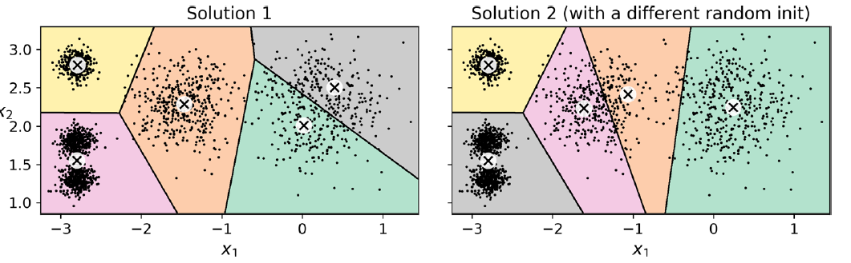
Watch out for local minima!

Slide 41
Convergence
Sec. 16.4
Several possibilities, e.g.,
A fixed number of iterations.
Data partition is unchanged.
Centroid positions don’t change 🡪 convergence
Does k-means always converge? i.e., reach a state in which clusters don’t change.
Yes. It does, as it minimizes the overall distortion towards a local optimum.
How to find a better minimum?
Solution: e.g. run it multiple times
K-means is a special case of a general procedure known as the Expectation Maximization (EM) algorithm.

Slide 42
Computational complexity
The computational complexity of the algorithm is generally linear with the number of instances N, the number of clusters K, and the number of dimensions m.
However, this is only true when the data has a clustering structure. If it does not, then the complexity can increase exponentially with the number of instances.
This is rare, and K-Means is generally one of the fastest clustering algorithms.

Slide 43
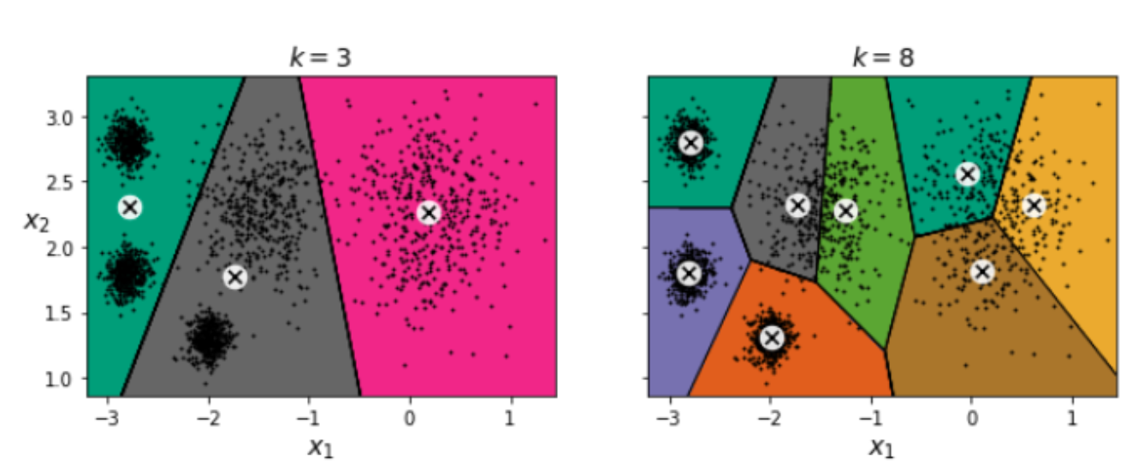
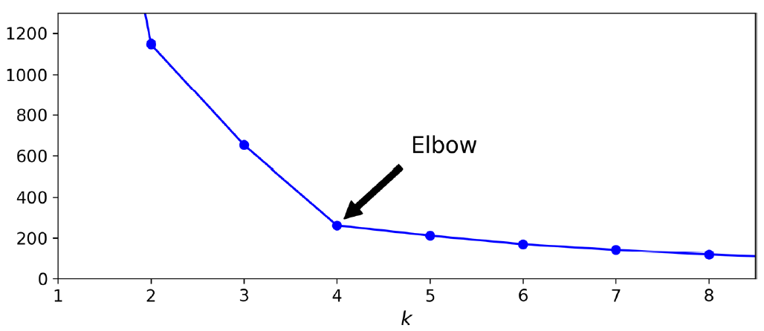
How many clusters?
Mean squared distance

Slide 44
Weaknesses of K-Means
The user needs to specify k
The algorithm is sensitive to outliers
Outliers are data points that are very far away from other data points
Outliers could be errors in the data recording or some special data points with very different values
Source: https://www.cs.uic.edu/~liub/
33

Slide 45
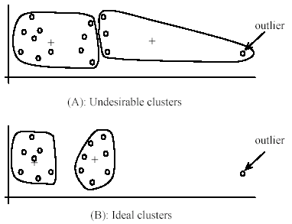
Weaknesses of k-means: Problems with outliers
Source: https://www.cs.uic.edu/~liub/
34

Slide 46
To deal with outliers
One method is to remove some data points in the clustering process that are much further away from the centroids than other data points
To be safe, we may want to monitor these possible outliers over a few iterations and then decide to remove them.
Another method is to perform random sampling
Since in sampling we only choose a small subset of the data points, the chance of selecting an outlier is very small
Assign the rest of the data points to the clusters by distance or similarity comparison, or classification
Source: https://www.cs.uic.edu/~liub/
35

Slide 47
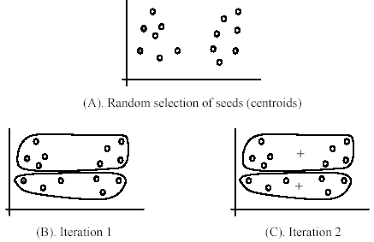
Weaknesses of k-means
The algorithm is sensitive to initial seeds

Slide 48
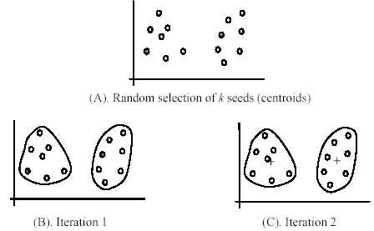
Weaknesses of k-means (cont …)
If we use different seeds: good results
There are some methods to help choose good seeds

Slide 49
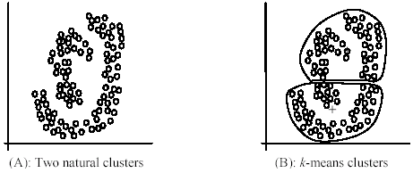
Weaknesses of k-means (cont …)
The k-means algorithm is not suitable for
discovering clusters that are not hyper-ellipsoids (or hyper-spheres)
+
Source: https://www.cs.uic.edu/~liub/
38

Slide 50
CLUSTER EVALUATION
Competitive Learning

Slide 51
Cluster Evaluation: a hard problem
The quality of a clustering is very hard to evaluate because we do not know the correct clusters
Some methods are used:
User inspection
Study centroids, and spreads
Entropy, Purity
Silhouette score
Source: https://www.cs.uic.edu/~liub/
42

Slide 52
Cluster evaluation: ground truth
We use some labeled data (for classification)
Assumption: Each class is a cluster.
After clustering, a confusion matrix is constructed. From the matrix, we compute various measurements, entropy, purity, precision, recall and F-score.
Let the classes in the data D be C = (c₁, c₂, …, c_{k}). The clustering method produces k clusters, which divides D into k disjoint subsets, D₁, D₂, …, D_{k}.

Slide 53
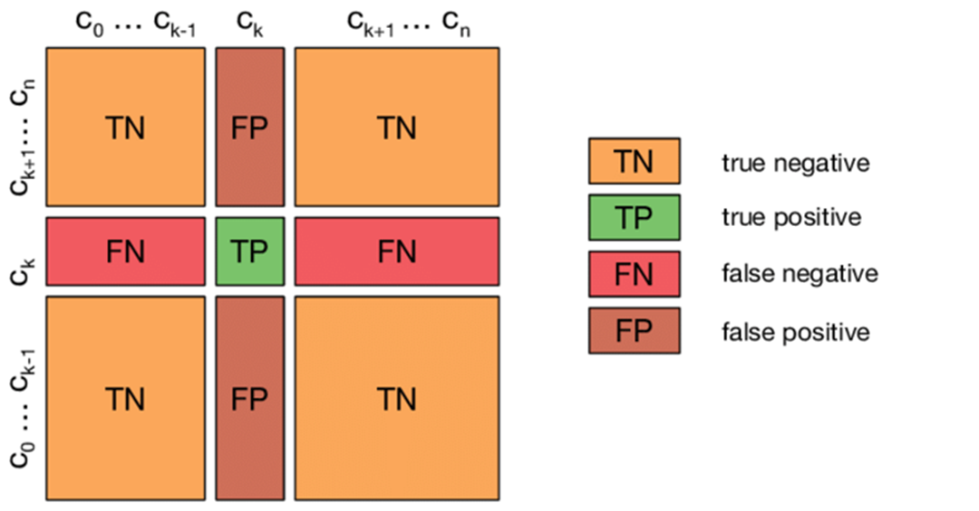
Multi-class Confusion Matrix
Actual classes
Predicted clusters

Slide 54
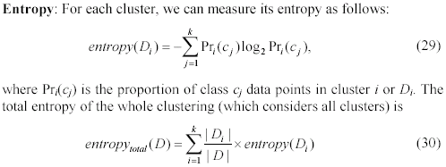
Evaluation measures: Entropy
Source: https://www.cs.uic.edu/~liub/
44

Slide 55
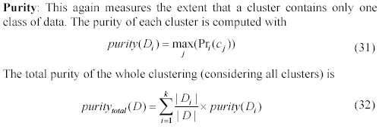
Evaluation measures: purity
Source: https://www.cs.uic.edu/~liub/
45

Slide 56
Evaluation based on internal information
Intra-cluster cohesion (compactness):
Cohesion measures how similar to each other the data points in the same cluster are
i.e., how near they are to the cluster centroid.
Sum of squared error (SSE) is a commonly used measure.
Inter-cluster separation (isolation):
Separation means that different cluster centroids should be far away from one another.
Source: https://www.cs.uic.edu/~liub/
48

Slide 57
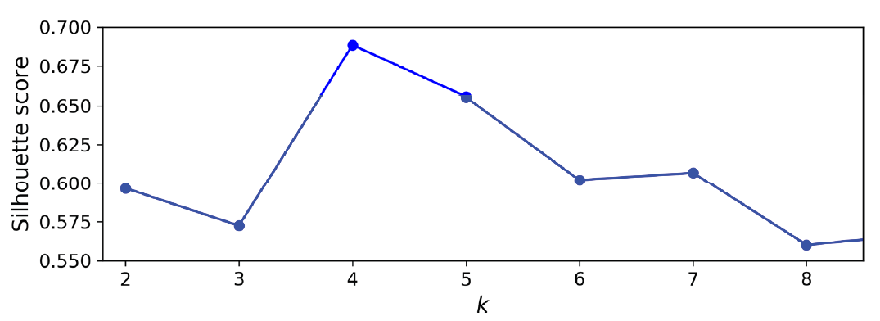
Silhouette score
Silhouette score measures how similar an instance is to its own cluster (cohesion) compared to other clusters (separation) and ranges from −1 to +1.
If most instances have a high value, then the clustering configuration is appropriate. If many points have negative values, then there are too many or too few clusters.

Slide 58
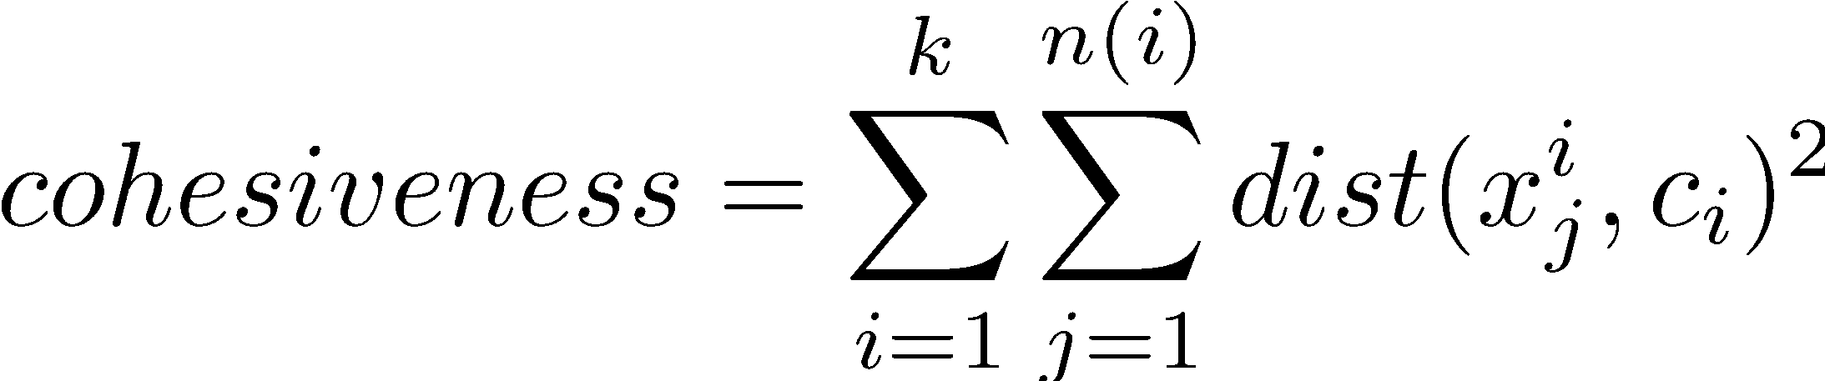
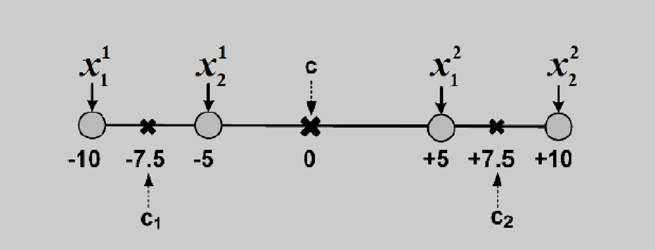
Cohesiveness
Cohesiveness
In statistical terms, this is equivalent to having a small standard deviation, i.e., being close to the mean value.
In clustering, this translates to being close to the centroid of the cluster
Notes:
Is higher cohesion better or smaller?
What is this c?

Slide 59
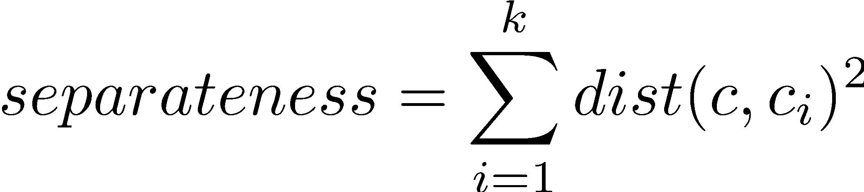
Separateness
Separateness
We are also interested in clusterings with clusters that are well separated from one another.
In statistics, separateness can be measured by standard deviation.
Standard deviation is maximized when instances are far from the mean.
In clustering terms, this is equivalent to cluster centroids being far from the mean of the entire dataset
Notes:
Do we want higher or smaller?

Slide 60
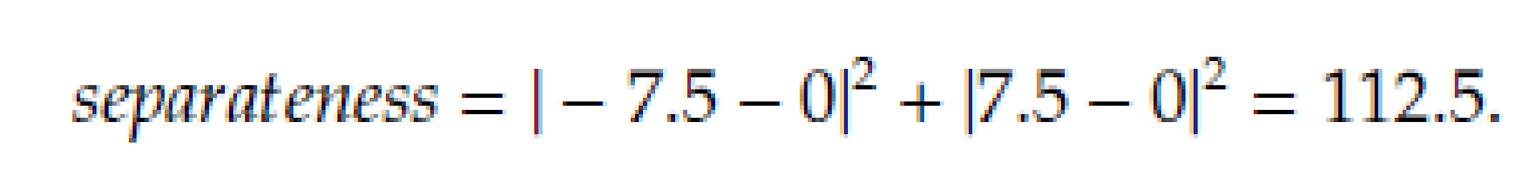
Separateness Example
In general we are interested in clusters that are both cohesive and separate -> Silhouette index

Slide 61
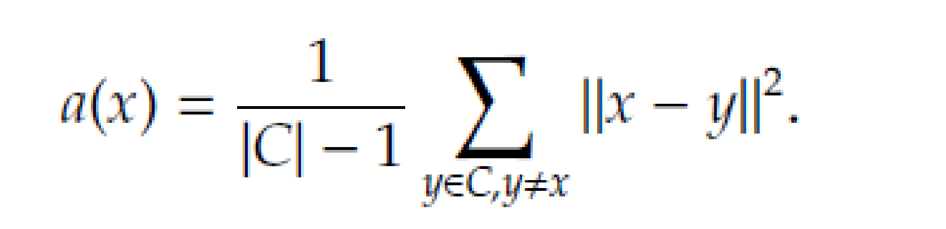
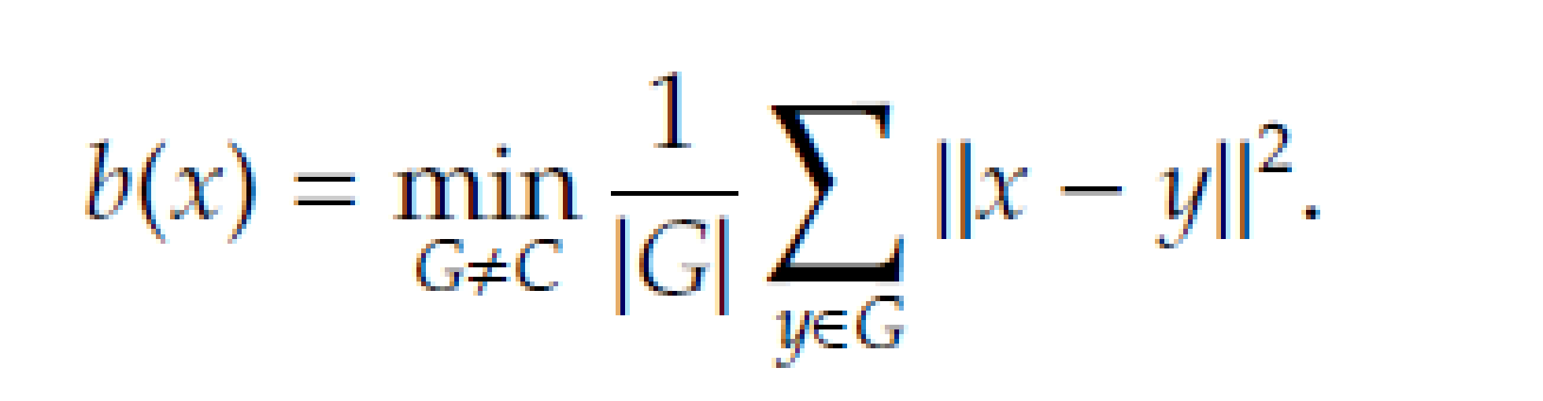
Silhouette Index
For any instance x that is a member of cluster C
Compute the within-cluster average distance
Compute the average distance between x and instances in cluster G that is closest to x in terms of the average distance between x and members of G

Slide 62
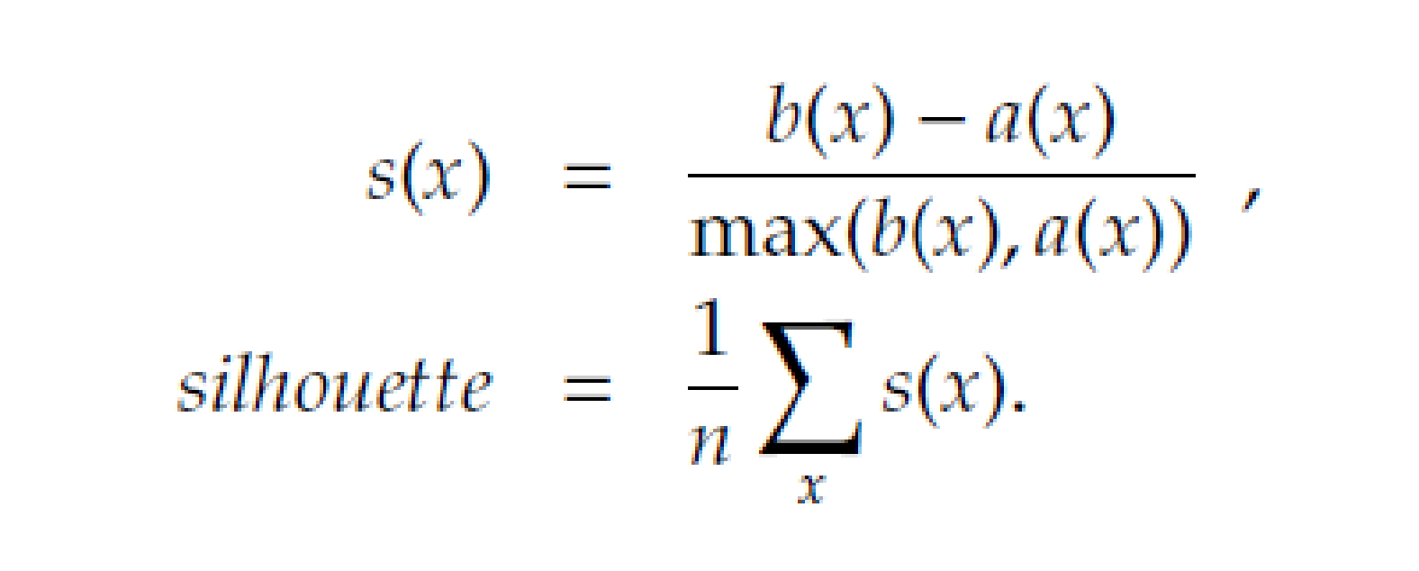
Silhouette Index
Clearly we are interested in clusterings where a(x)<b(x)
Silhouette can take values between [-1,1]
The best case happens when for all x,
a(x)=0, b(x)>a(x)

Slide 63
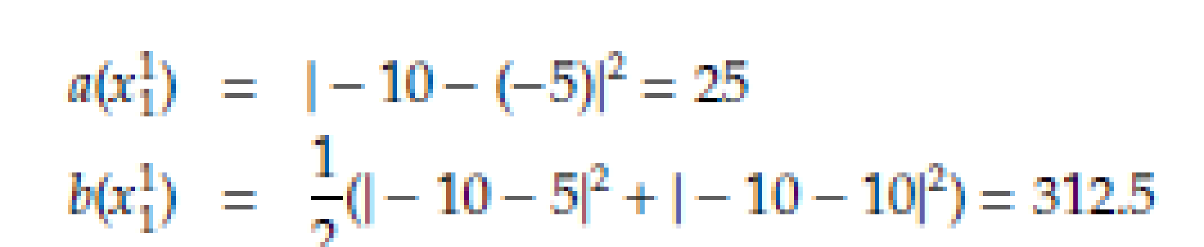
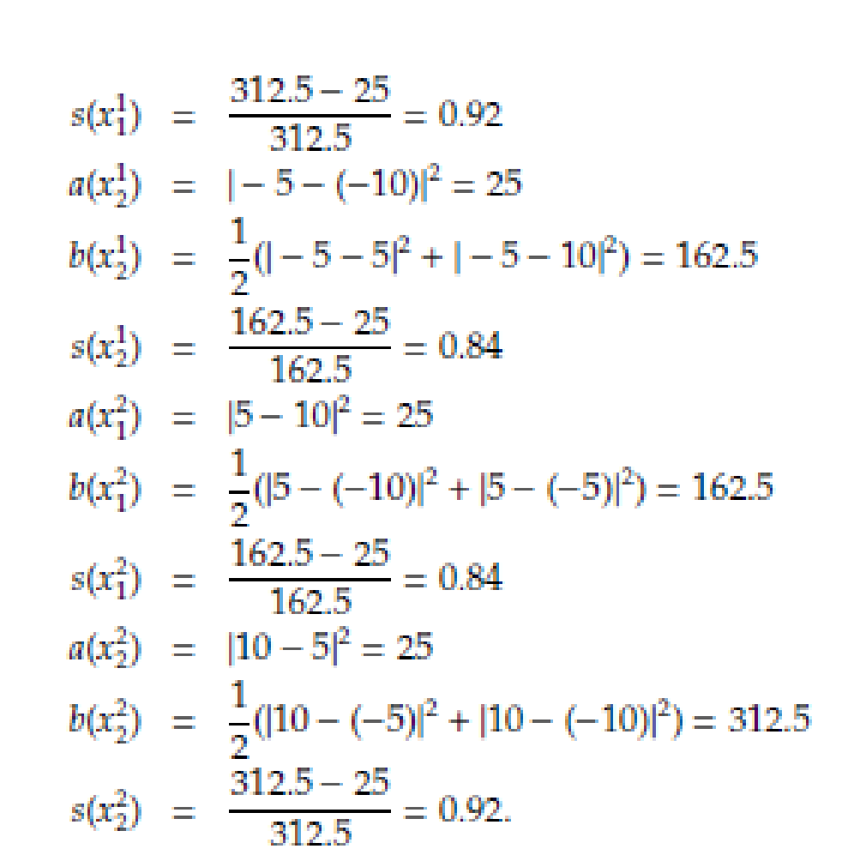
Silhouette Index - Example
Notes:
225 + 400 = 625 / 2 = 312.5

Slide 64
Other clustering methods
DBSCAN
Clusters as continuous regions of high density. Good for spatial clustering
Can identify any number of clusters of any shape (with 2 hyperparameters)
Robust to outliers
Affinity propagation
Every data point votes for another data point as its representative
After convergence, each representative and its voters form a cluster
Computationally expensive
Spectral clustering
Creates a low-dimensional embedding from the similarity matrix
Can capture complex cluster structures
Efficient approximate methods

Slide 65
GAUSSIAN MIXTURE MODELS
Gaussian Mixture Models

Slide 66


Illustration
Gaussian estimated from training data
Observed data
This test case has higher density than any of the training cases, but is quite probably an outlier

Slide 67
Illustration
This test case has low probability

Slide 68
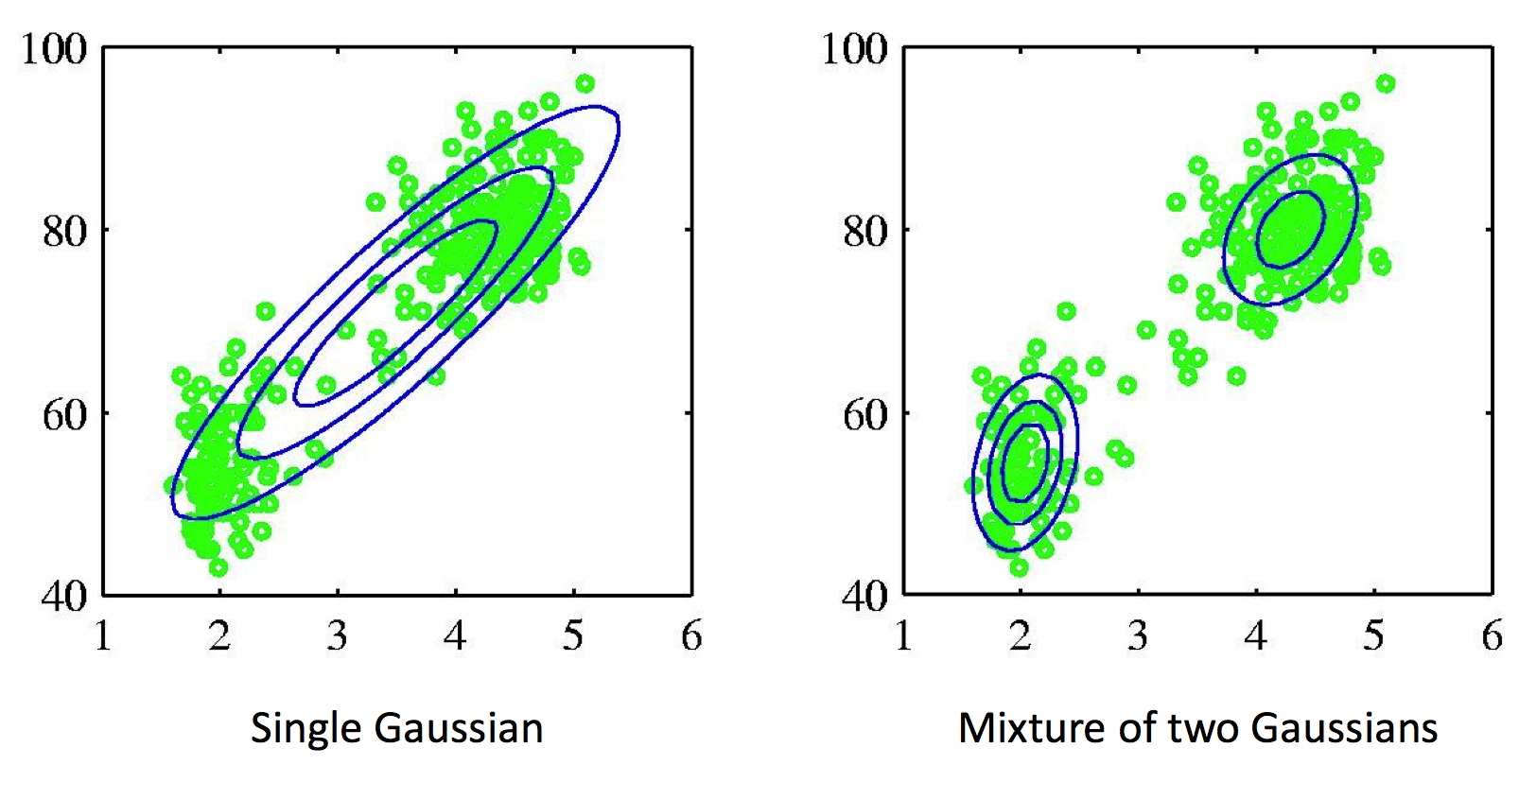
Mixture of Gaussians
Any data can be represented by a mixture of Gaussian clusters
Each cluster can have a different ellipsoidal shape, size, density, and orientation

Slide 69
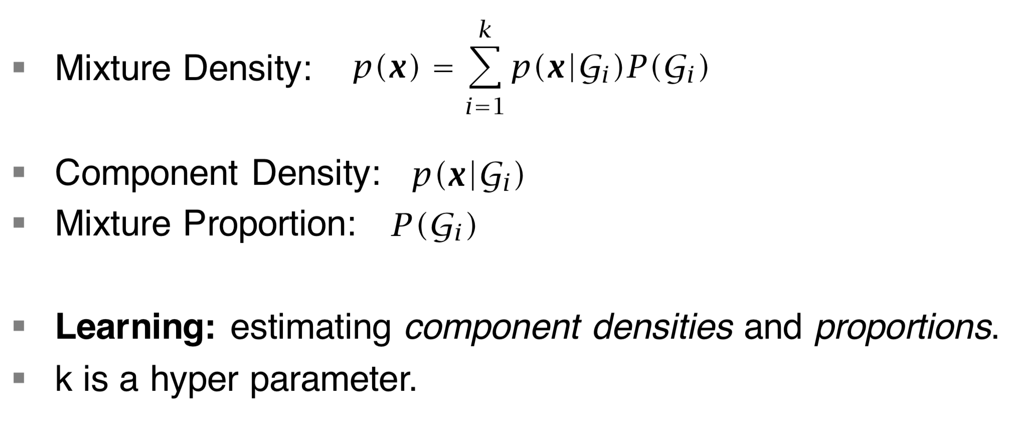
Mixture Densities

Slide 70
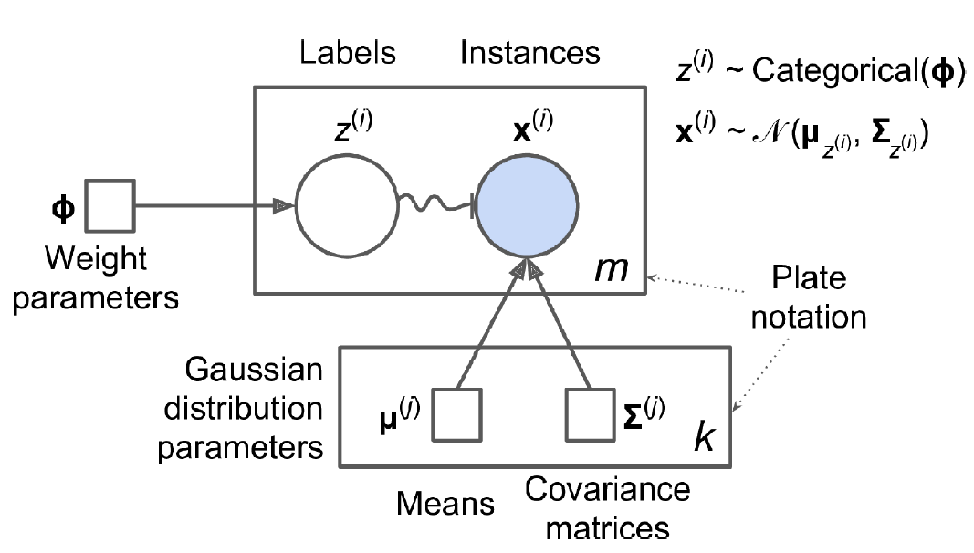
What are we learning?
Observed
Unknown – ‘latent’

Slide 71
Gaussian mixture models
Expectation-Maximization algorithm (EM algorithm): Iterative algorithm that finds the model parameters for which the observed data is most likely
Parameters: mean and covariance
E-step: Estimate labels/responsibilities for data given the parameters.
M-step: Update parameters given the estimated labels of E-step.
Repeat until convergence.
K-means is a special case of EM algorithm
Issues: Can end up in local minima, number of mixtures again is to be chosen and validated

Slide 72
Summary
Why learning from unlabeled data is important?
Clustering algorithms
Hierarchical clustering
K-means
Gaussian mixture models
Expectation Maximization
Non-parametric methods
Probability density estimation
Dimensionality reduction/data embedding

Slide 73
Unsupervised methods, cont.
Keith Burghardt
January 22, 2024

Slide 74
Reminders
Quiz at 5:40 p.m. TODAY on material from class
Jan 31: Project Proposals Due
Feb. 7
HW2 due (will be assigned tonight)
Next quiz

Slide 75
TA office hours
Fiona
Ashwin
Wednesdays
10AM - 11AM PT
https://usc.zoom.us/my/siyiguo
Mondays
10AM - 11AM
https://usc.zoom.us/j/9026240639

Slide 76
NONPARAMETRIC ESTIMATION

Slide 77
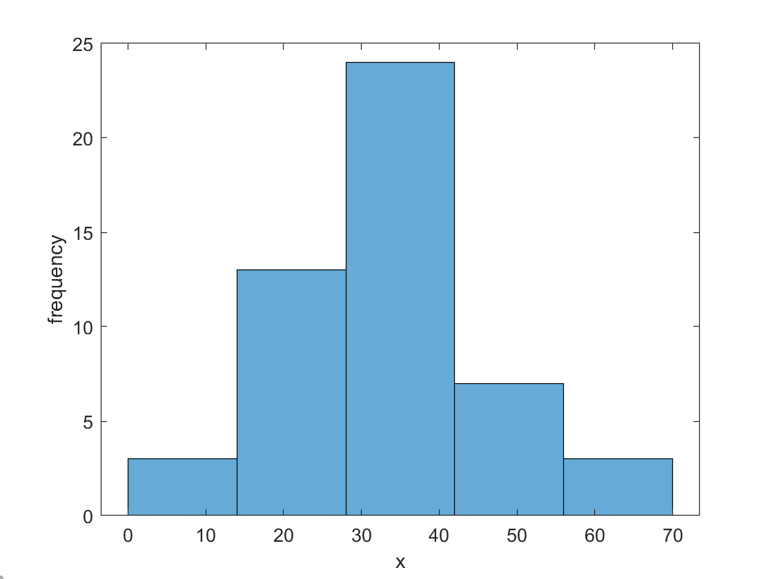
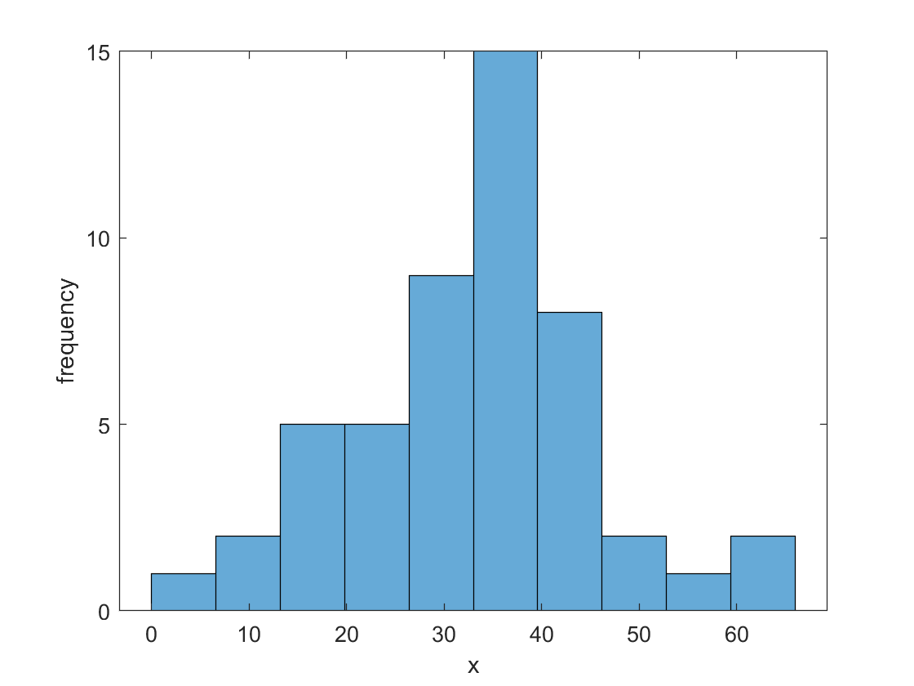
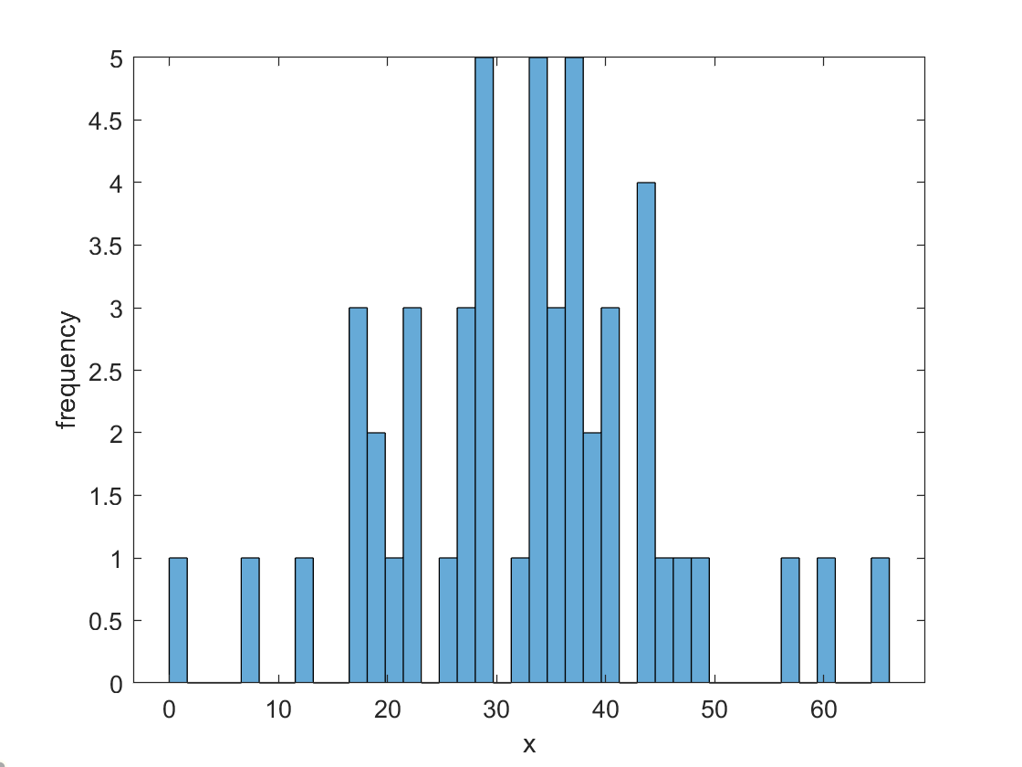
Histogram
Histogram is the most popular way to visualize data
Bin size changes the shape of the histogram
For normal data, use equal size bins
5 bins
10 bins
40 bins

Slide 78
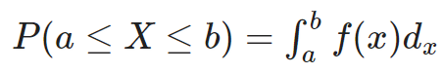
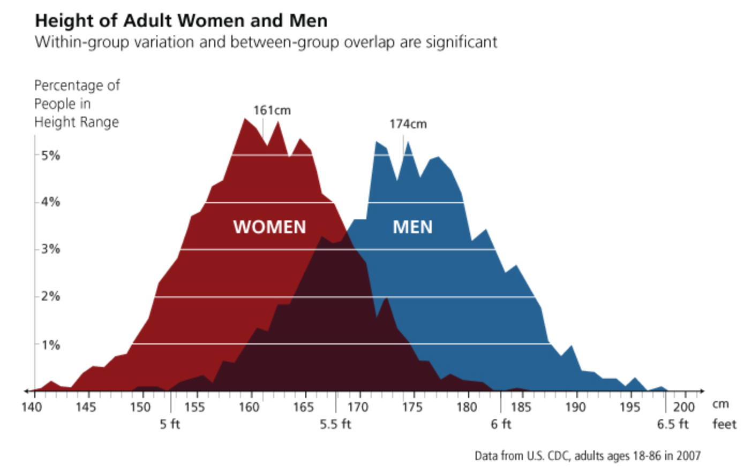
Probability density
Probability density function f shows you where the data is:
Note: y-value does not give the probability of observing data point x
Instead, think of areas; Area under the pdf has to be 100%
Must be estimated from data: parametric vs nonparametric

Slide 79
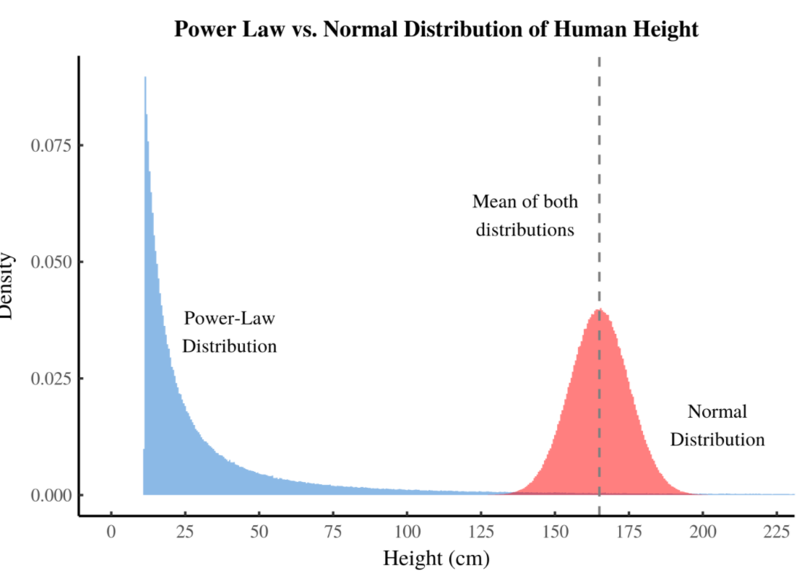
Normal vs skewed data
Equal size bins have sparse data in the tail; use log bins
Source: https://economicsfromthetopdown.com/2019/04/25/visualizing-power-law-distributions/

Slide 80
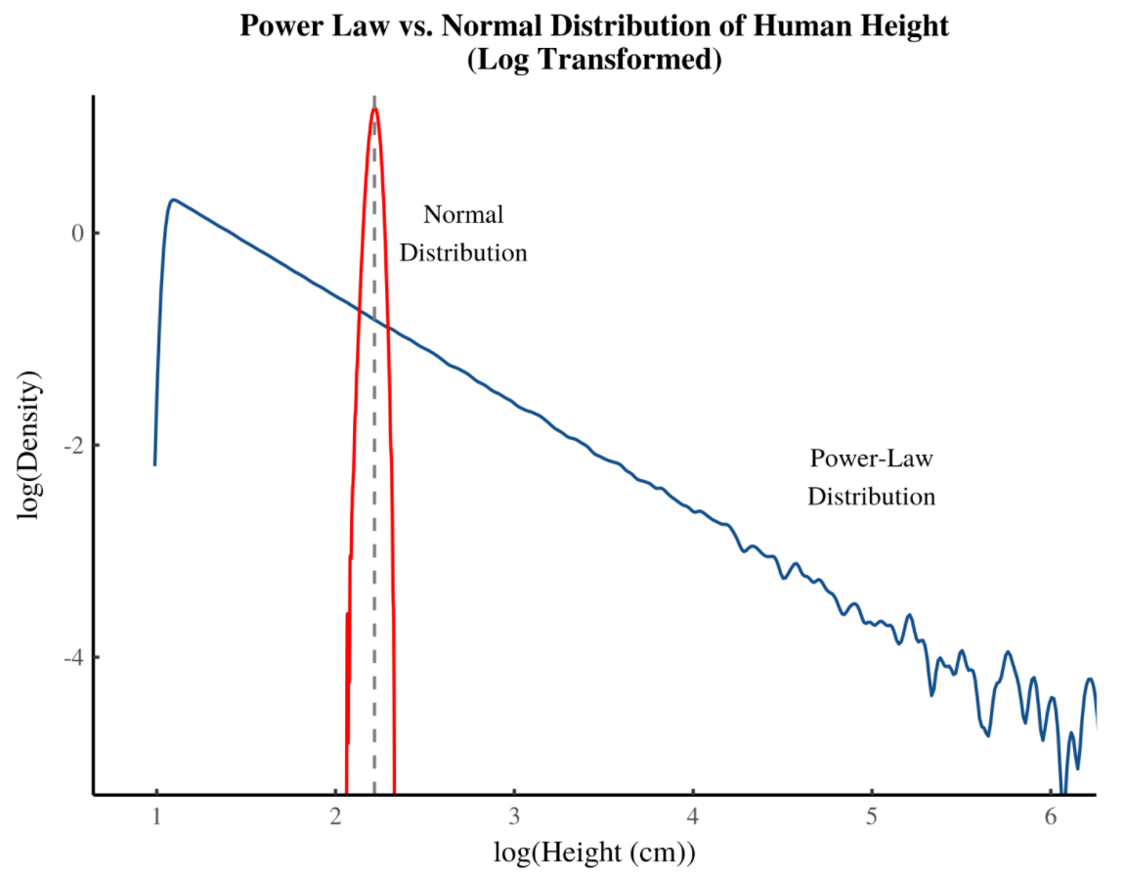
Normal vs skewed data
Source: https://economicsfromthetopdown.com/2019/04/25/visualizing-power-law-distributions/

Slide 81
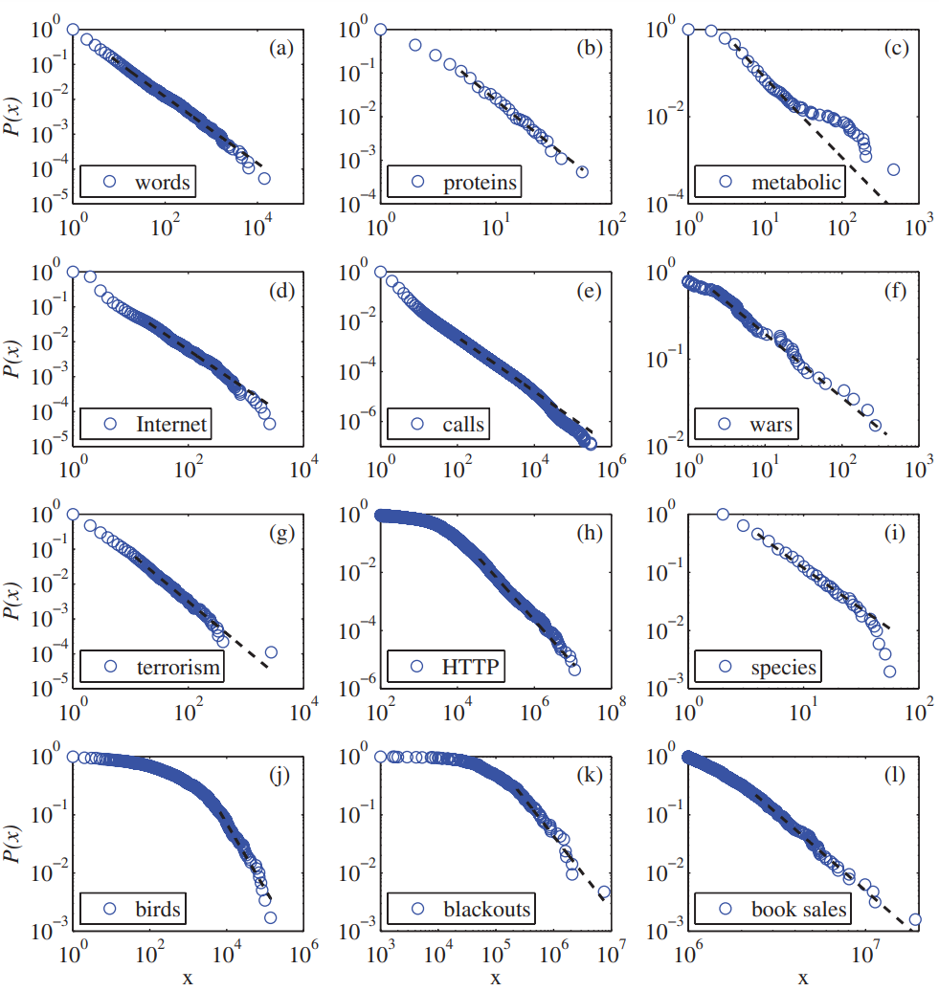
Lots of data is highly skewed
(a) Frequency of unique words in Moby Dick by Herman Melville.
(b) Degree distribution of protein interaction network.
(c) and metabolic network of E. coli.
(d) Degree distribution of autonomous systems on the Internet.
(e) Number of long-distance phone calls received by AT&T customers.
(f) Number of deaths in wars from 1816–1980 measured.
(g) Deaths due to terrorist attacks worldwide 1968 -2006.
(h) Number of bytes by HTTP (web) requests.
(i) The number of species per genus of mammals during the late Quaternary period.
(j) Frequency of sightings of bird species in the US.
(k) Number of customers affected by blackouts in the US.
(l) The sales volume of bestselling books in the US.
Clauset, A., Shalizi, C. R., & Newman, M. E. (2009). Power-law distributions in empirical data. SIAM review, 51(4), 661-703.

Slide 82
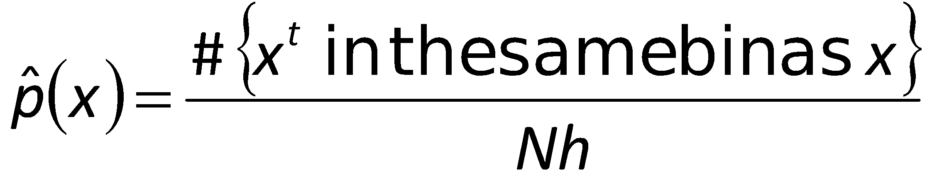
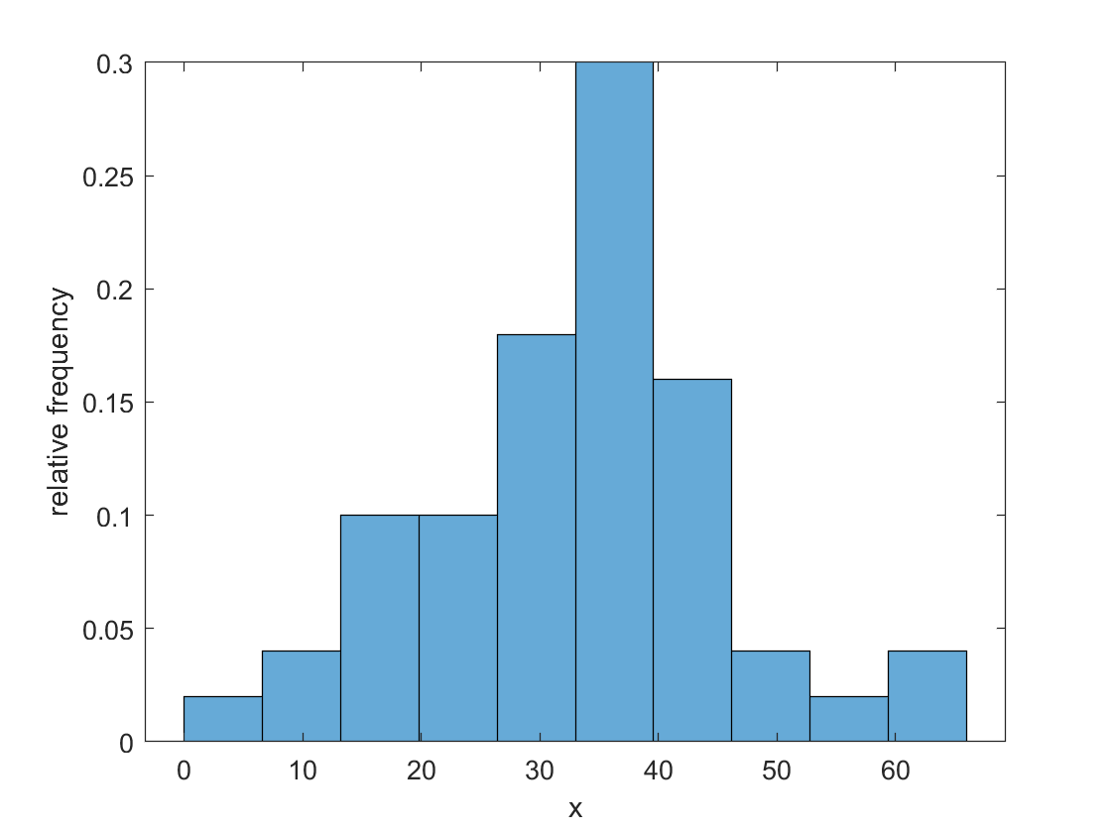
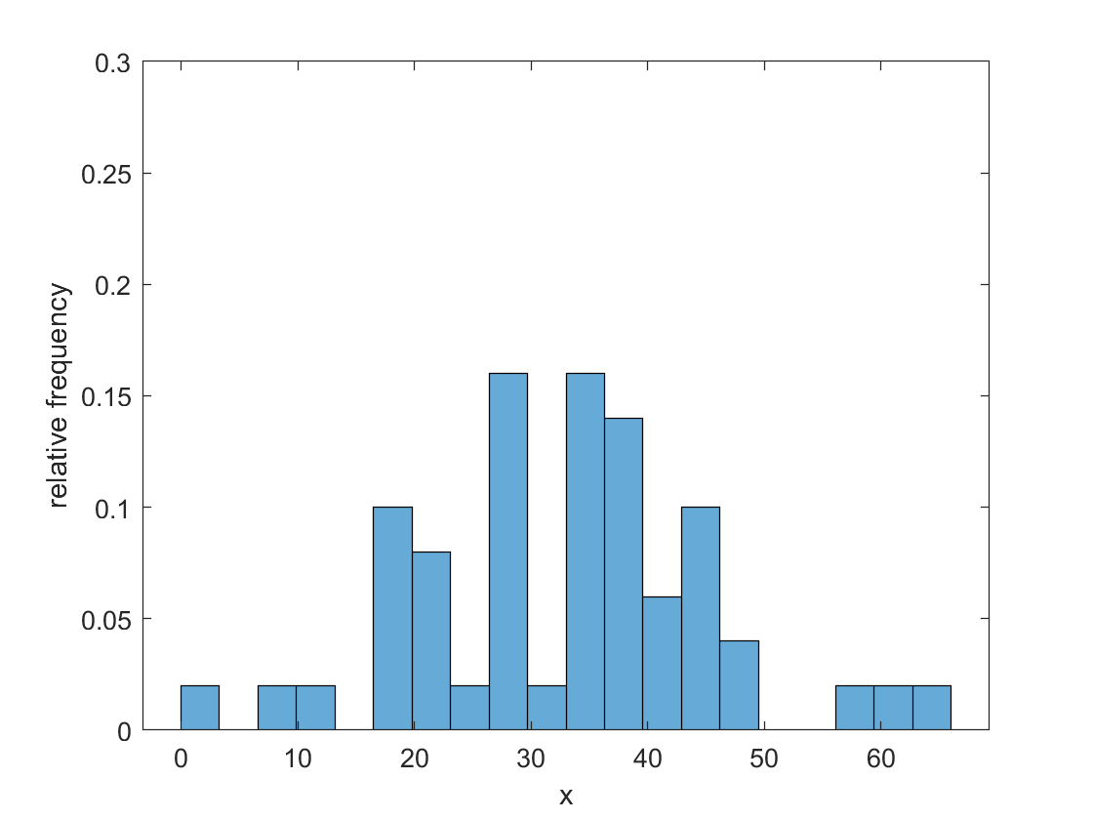
Density Estimation
Given the training set X={x^{t}}_{t} drawn iid from p(x)
Divide data into bins of size h
Histogram:
Area equals 100%
Estimator often not smooth
Notes:
Why do we care if it’s smooth?

Slide 83
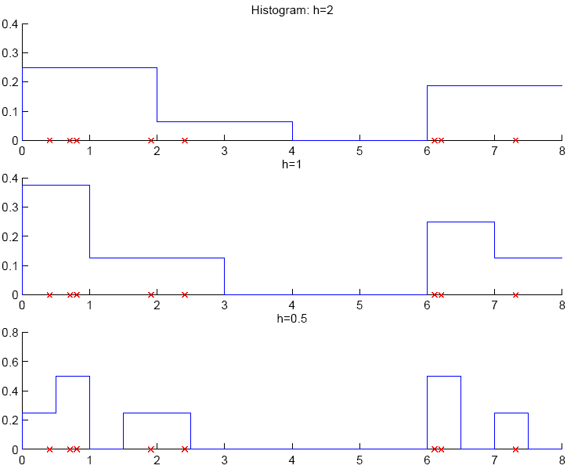

Slide 84
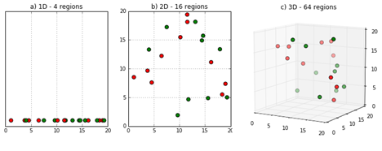
Multivariate Data
Watch out for using non-parametric estimates with high-dimensional data: curse of dimensionality
Example: dim(X)=8, and we use a histogram with 10 bins per dimension
10^8 bins, most will be empty
Estimates will be mostly zero
Choose bin size carefully

Slide 85


Kernel Estimator
Smoothing the estimators
Kernel function, e.g., Gaussian kernel:
Kernel estimator (Parzen windows)

Slide 86

What is the right bandwidth/bin size?
Gaussian kernel KDE:
Scott’s Rule
n^{-1/(d+4)}
for dimension d, number of point, n
Silverman’s Rule
[n(d+2)/4]^{-1/(d+4)}
Bandwidth and accounting for data skewness (e.g., log-binning) more important than type of kernel
h=0.5
h=0.25
h=0.125

Slide 87
Outlier Detection
Find outlier/novelty points
Not a two-class problem because outliers are very few, of many types, and seldom labeled
Instead, one-class classification problem: Find instances that have low probability
In nonparametric case: Find instances far away from other instances

Slide 88
VISUALIZING HIGH DIMENSIONAL DATA USING DIMENSIONALITY REDUCTION TECHNIQUES
Principal component analysis

Slide 89

Visualizing high dimensional data
No visualization is available for high dimensional data (only partially; lose a lot of information)
Methods to allow us to visualize/analyze data from higher dimensions in lower dimensions without losing a good part of the information
Dimensionality reduction

Slide 90




Reducing dimensions always cause distortions

Slide 91
Dimensionality reduction
Given dataset R with m rows(observations) and n columns(features).
Create a new dataset with m rows and n’ columns that best summarizes the original data
n’<<n, where n is a large number (n>>3)
Two common solutions
PCA (Principal Component Analysis)
t-SNE ( t-distributed Stochastic Neighbor Embedding)
Visualizing Data using t-SNE (original paper)

Slide 92

PCA (Principal Component Analysis)
Consider the original data set with m rows and n columns as a matrix R (columns of R should be standardized)
The goal is to find two low rank P (m rows, n’ columns) and Q (n’ rows, n columns)
such that R’ = PQ best approximate R. minimize ||R - R’||_{F}
Then P is the low dimensional version of R. Rows of Q are the n’ features extracted, represented in original n dimensional space.

Slide 93

PCA (Principal Component Analysis)
How do we calculate P and Q?
Intuition -- The n data points distributed along certain axes in the m dimensional space.
The axes are given by the eigenvectors of covariance matrix
C = R^{T}R.
Find only first n’ eigenvectors with largest absolute eigenvalues. Project data to those axes.

Slide 94

Principal Component Analysis - PCA
Unsupervised method that identifies the internal structure of high-dimensional data that best explains its variance
Embeds the data in a new lower-dimensional space, such that
The first component is that (normalized) linear combination of the variables with the largest variances.
The second principal component has largest variance, subject to being uncorrelated with the first….etc.
Thus, with many correlated features, we replace them with a small set of principal components that capture their joint variation.

Slide 95

PCA (Principal Component Analysis)
Eigenvectors are orthogonal towards each other and have length one
The first couple of eigenvectors explain most of the variance observed in the data
Low eigenvalues indicate little loss of information if omitted

Slide 96

Principal Component Analysis
Use cases for PCA:
Data compression
Feature selection and feature reduction
Data visualization
Eigenfaces are the principal components of a large set of “faces”
Shape
Hair
Beard
Glasses
…

Slide 97


Fair PCA
(Labeled Faces in the Wild)
Samadi, Samira, et al. "The price of fair PCA: one extra dimension." Proceedings of the 32nd International Conference on Neural Information Processing Systems. 2018.
Notes:
LFW = labeled faces in the wild

Slide 98


Fair PCA
Ensure reconstruction loss for two groups, A and B, is similar.
Notes:
\hat{Y} b ∈ R a×n be the optimal rank-d

Slide 99

Fair PCA

Slide 100
t-distributed Stochastic Neighbor Embedding (t-SNE)
Nonlinear dimensionality reduction technique for embedding high-dimensional data in a low-dimensional space (two or three dimensions)
Used for visualizing high-dimensional data
Models each object as a 2- or 3-dimensional point such that similar objects are modeled by nearby points and dissimilar objects are modeled by distant points with high probability.

Slide 101



t-SNE (t-distributed Stochastic Neighbor Embedding)
For original data, define similarity measures
Where
Define the similarity measures of transformed data (y) as

Slide 102



t-SNE (t-distributed Stochastic Neighbor Embedding)
And set
Minimize
Using gradient descent.
Intuition: Similar data observations are located closer in the transformed space.

Slide 103



Example -- Handwritten digits images
Original data (8*8 images, 64 dimensions)
Less informative dimensions
More informative dimensions
PCA
t-SNE

Slide 104


Example -- Adult Dataset (Tabular)
Adult dataset contains features of individuals. The outcome is whether the person makes $50K annually. (shown as yellow)
PCA
t-SNE

Slide 105

UMAP
Preserves relative position of neighbors
Preserves global relations better than t-SNE
Alike to t-SNE, hyperparamters matter
Play around with different ways to visualize here: https://pair-code.github.io/understanding-umap/
https://pair-code.github.io/understanding-umap/

Slide 106
Summary
PCA
Linear
Global structure
Affected by outliers
Deterministic
Fitting data to an ellipsoid
t-SNE
Nonlinear
Local structure
Not sensitive to outliers
Stochastic
Based on data similarity
Usually the best method for image data
UMAP
Nonlinear
Global structure
Not sensitive to outliers
Stochastic
Based on data similarity
Good for visualizations, dimensional reduction

